Slide 1

哈尔滨教育云平台
人人皆学、处处能学、时时可学

Slide 2
Unit 2 Presenting ideas and projects
高中英语-外研社版-必修一-课时6
哈尔滨市师大附中-耿文静

Slide 3
Creative ways to learn English
Change your mobile phone language to English
Switch everything to English on a daily basis.
（ phone ,TV, films, computer, your tablet ,instructions of a product ….etc）
•Take a hobby and learn it in English.
（ cooking, singing English songs, playing games..etc ）
• Use an APP or programme instead of attending a language school

Slide 4
Useful expressions
I think …is the most creative idea.
It can help us…
At first, we can…
Then ,…
Last but not least, …

Slide 5
An example of a presentation
I think is the most creative idea to learn English well .
At first, It can help us . Second, we should as much
as possible, which will surely improve . We'd better
Third, we can also . It's also good for us. At last, we
should .
In a word, as long as we ,we will learn English well。
.

Slide 6
Mistranslations in public places
Q：What kind of errors can you find？

Slide 7
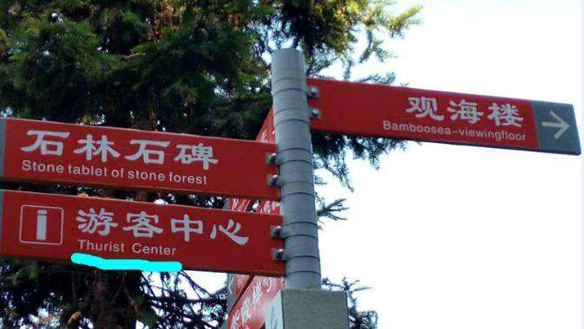
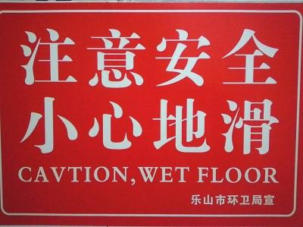
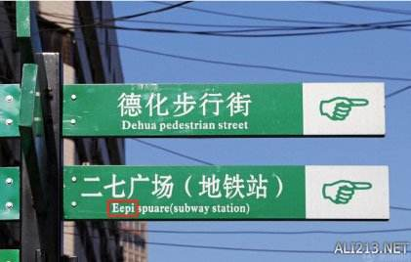
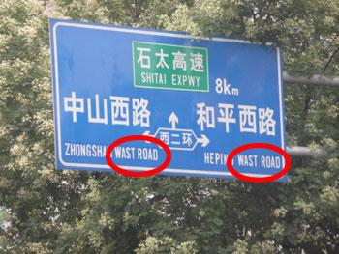
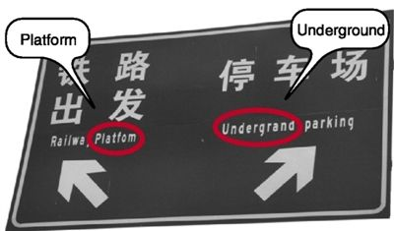
Road sign

Slide 8
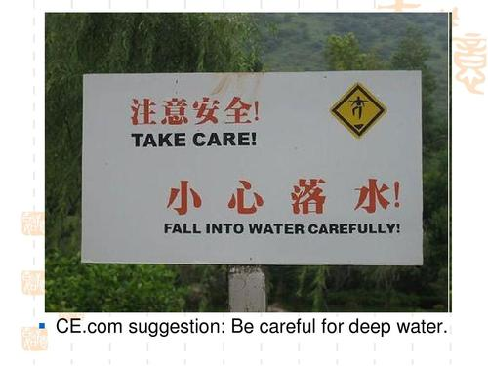
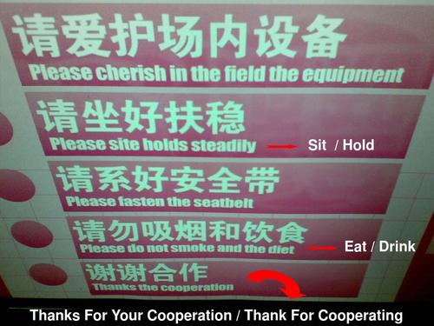
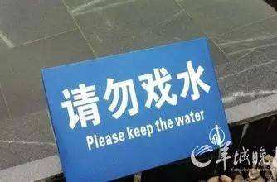
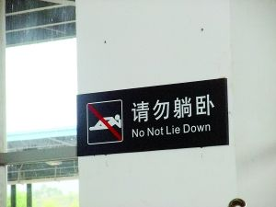
public sign

Slide 9
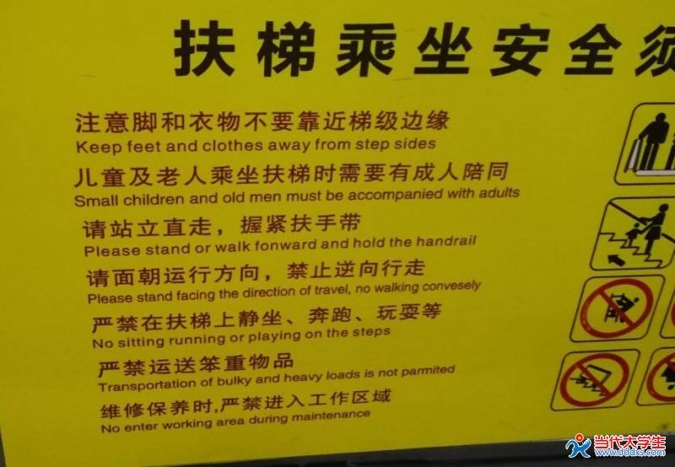
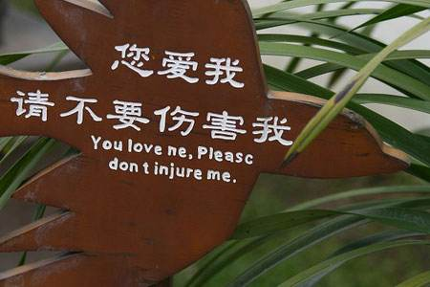
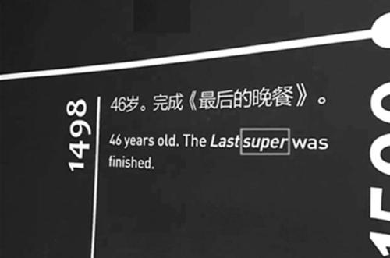
public sign

Slide 10
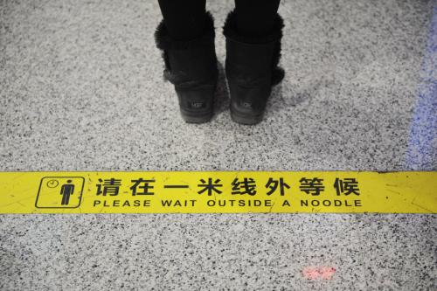
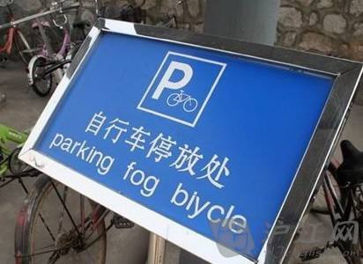
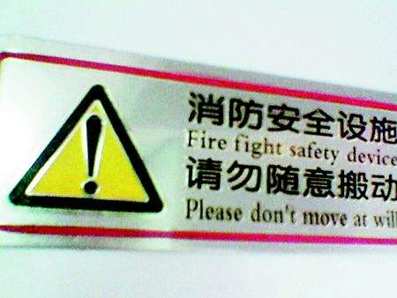
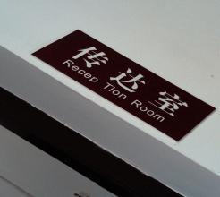
Public signs

Slide 11
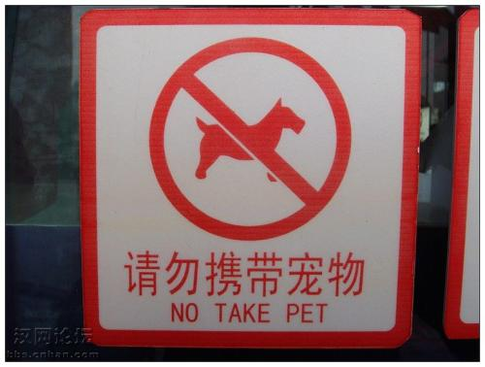


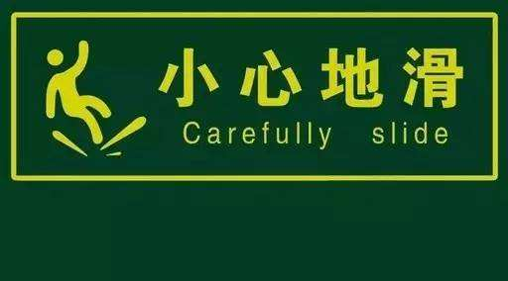

Slide 12

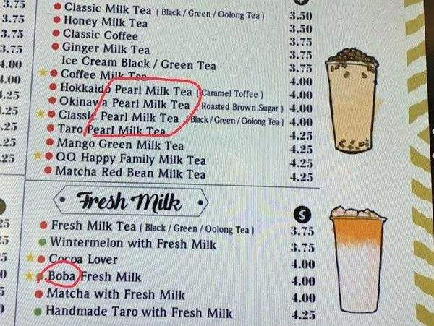
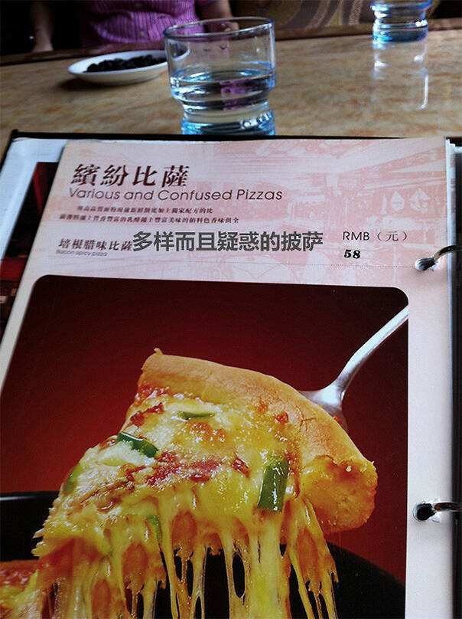
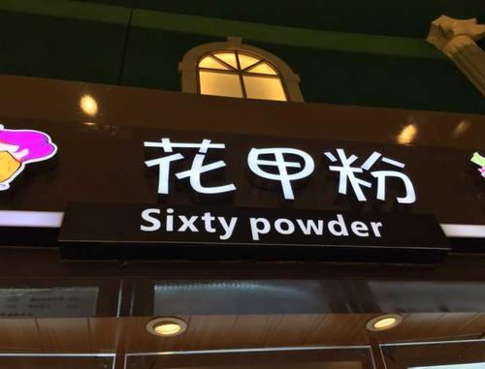
Restaurant menu

Slide 13
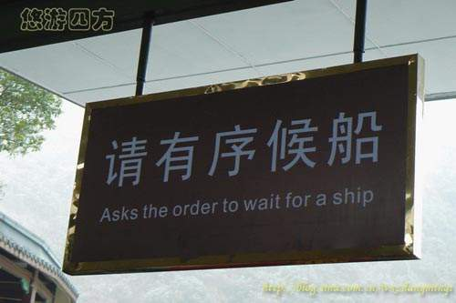

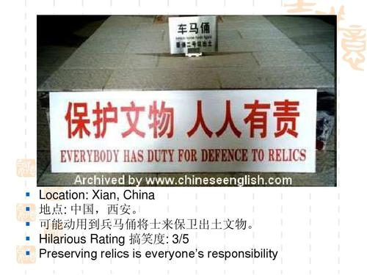

Tourist spots

Slide 14
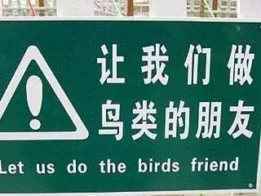
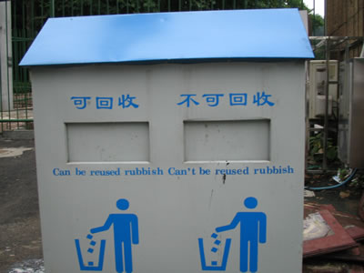
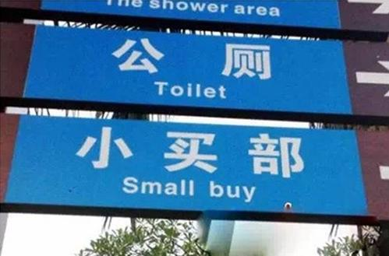
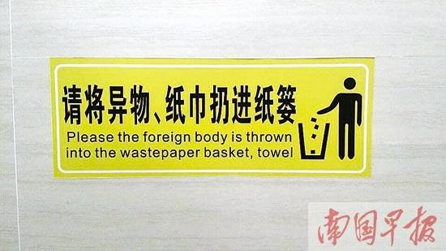

Slide 15
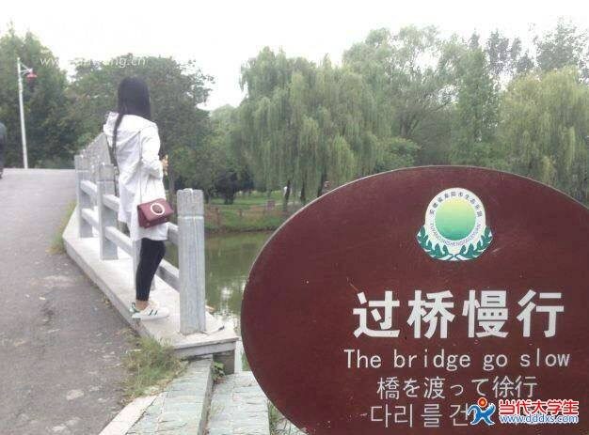

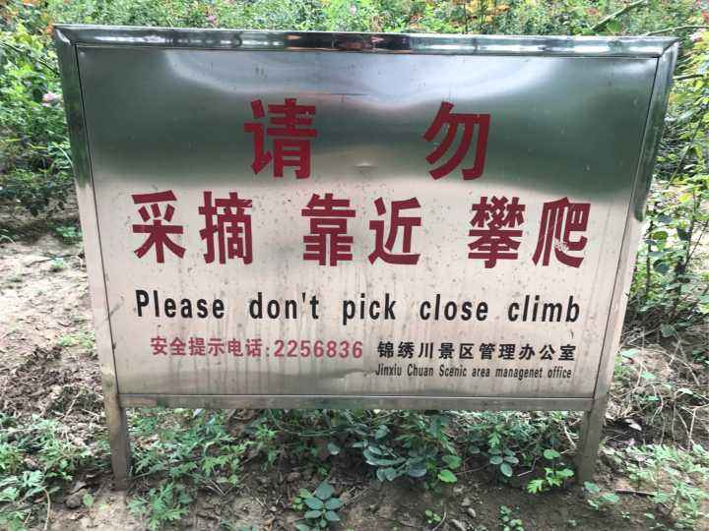
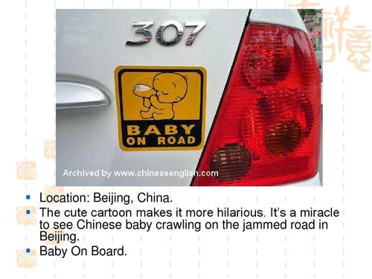

Slide 16
Classify the mistakes in public signs
• grammar mistakes
• wrong choice of words
• spelling mistakes
• word for word translation
• other….

Slide 17
Features of the public signs：
－brief and to the point
•Letters in capitals, no comma
•Less words
•n./v./noun phr./v-ing/祈使句
注意固定用法，符合英语表达习惯

Slide 18
闲人免进 no lazy people
出口 export
欢迎再次光临 welcome you again
请勿吸烟 please do not smoke
当心撞头 attention your head
请勿乱丢垃圾 no litter
staff only
exit
welcome again
no smoking
mind your head
no littering

Slide 19
Mistranslations in public places
Project
•Investigate think about public places
Plan discuss what the mistakes are
correct the translations
Create photos, slide presentation,notebooks
Present show your list of mistranslations to the
class and explain the reason.

Slide 20
Project
location | Chinese | English mistranslation

Slide 21
谢谢观看

